Slide 1
Woodstock Walls
Matthew Del Greco
Notes:
This file created for Ashley Tignor. DO NOT DELETE -> %(66B46993C46B3139-813E73F1955FAC06)%

Slide 2
Expanding the Arts
Tour artist studios
Visit galleries
Attend lectures by artists
Woodstock Walls Completes the Circle

Slide 3
Participating NY Galleries
Westfield Gallery, Armonk
Flores & Sons, New Paltz
Photographic Marvels, Rochester
Falls Gallery, Buffalo
Tinker Street Studios, Woodstock

Slide 4
Participating Artists
Emily Catalan
Michael Robins
Erica Madison
Rhoda Altman
Alex Bard

Slide 5
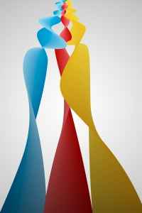
Artists Retreat Tour
Located in Hurley
Tours include a 2 hour class
Lunch included
Historic monastery retreat
Facilities
  Exhibitions
  Gardens
  Shops
  Restaurant
  Studio

Slide 6
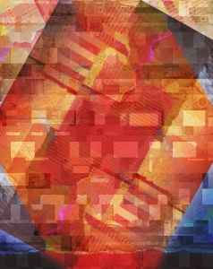
Emily Catalan- Artist
Exhibits in New York, Paris, and London
MFA Yale University
Awards and Honors
Preferred media
  Mixed media
  Pottery
Lives locally in Ulster County

Slide 7
Sample Lectures
Modern Masters - Oils
Earth Tones - Clay
Method Metals – Steel and Iron Sculptures

