Slide 1

group project math 1040
Group 3:
Vivian Dinh, Sunny Davis, Ashley Tignor, Jessica Shake.

Slide 2
Purpose of study
For SLCC students attending the Redwood campus, does hours of exercise per week relate to cumulative GPA?

Slide 3
Study Design
Plan
Systematic Sampling everyone who walk into SLCC Student Center at Redwood Campus
Survey
Randomly selected k=5 and will start with the 4th person that walks in the door
Collect data
Total of 100 people

Slide 4
Group 3 Data Results
Hours of exercise per week | GPA
4 | 3.1
3 | 3.92
4 | 2.79
6 | 3.8
2 | 2.5
3 | 3.06
1 | 2.5
6 | 3.7
3 | 3
3.5 | 2.5
2.5 | 2.96
7 | 2
2 | 3.78
8 | 2.5
3 | 3.4
0.5 | 3.9
3 | 3.8
0 | 3.4
0 | 2.7
0.5 | 2.7
1 | 3.9
1 | 3.7
4 | 2.9
2 | 3.3
2 | 3.3
3 | 3.8
4 | 2.5
5 | 3
1 | 3
0 | 2.6
8 | 2.9
3 | 2.1
6 | 3
0 | 3.5
0 | 2.5
10 | 3
8 | 2.5
8 | 4
0 | 3.7
8 | 3
6 | 3.5
8 | 2.5
10 | 2
5 | 3.8
4 | 2.9
10 | 3.5
2 | 3
8 | 3
1 | 3.4
15 | 3.2
3 | 4
5 | 2.2
8 | 3.1
4 | 1.5
2 | 2.5
3 | 3.5
3 | 3
1 | 2.5
3 | 3.35
3.5 | 2.9
6 | 3.8
5 | 3
2 | 2.3
5.5 | 3.1
3 | 2.5
10 | 3
2.5 | 3.5
2 | 2
4 | 2.95
6 | 3.2
1.5 | 2.76
7 | 2.1
0 | 3.86
5 | 3.5
2 | 3.2
5 | 3.5
2 | 3.7
3 | 2.85
0 | 2.6
6 | 2.9
5 | 3
4 | 2.9
3 | 3.9
5 | 4
0 | 2.75
5 | 3.9
4 | 3.62
0 | 2.5
3 | 2.4
4 | 2.9
5 | 3
2 | 3.5
5 | 2
10 | 3.45
0 | 4
3 | 4
3 | 2.4
6 | 2.3
5 | 2.7

Slide 5
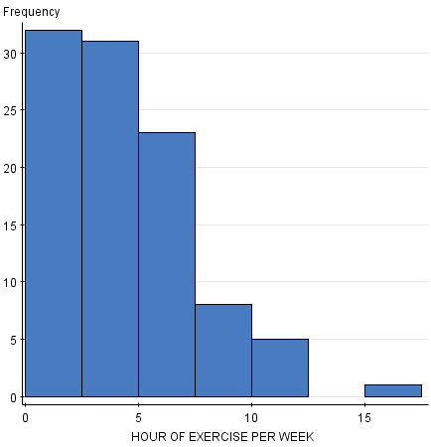
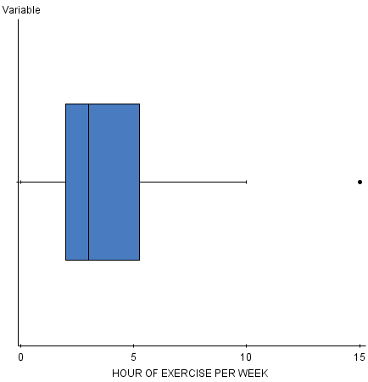
Hour of exercise per week graph

Slide 6
Hours of exercise per week
Our first qualitative variable is the hours of exercise per week for the SLCC students we interviewed.
Listed below is the data for hours of exercise per week data in ascending order.
Outliers: Q3-Q1=IQR 5.25-2=3.25
Q1-1.5(IQR)= Outlier 2-1.5(3.25)= -2.87
Q3+1.5(IQR)= Outlier 5.25+1.5(3.25)= 10.125
The outliers for this data is 15.
Minimum
Median
1st Quartile
0 | 0 | 0 | 0 | 0 | 0 | 0 | 0 | 0 | 0 | 0 | 0.5 | 0.5 | 1 | 1 | 1 | 1 | 1 | 1 | 1.5 | 2 | 2 | 2 | 2 | 2 | 2 | 2 | 2 | 2 | 2 | 2 | 2 | 2.5
2.5 | 3 | 3 | 3 | 3 | 3 | 3 | 3 | 3 | 3 | 3 | 3 | 3 | 3 | 3 | 3 | 3 | 3 | 3.5 | 3.5 | 4 | 4 | 4 | 4 | 4 | 4 | 4 | 4 | 4 | 4 | 5 | 5 | 5
5 | 5 | 5 | 5 | 5 | 5 | 5 | 5 | 5 | 5 | 6 | 6 | 6 | 6 | 6 | 6 | 6 | 6 | 7 | 7 | 8 | 8 | 8 | 8 | 8 | 8 | 8 | 8 | 10 | 10 | 10 | 10 | 10
15
3rd Quartile
Maximum

Slide 7
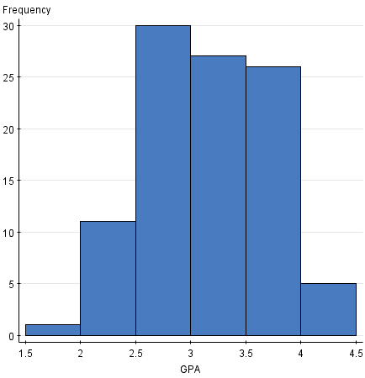
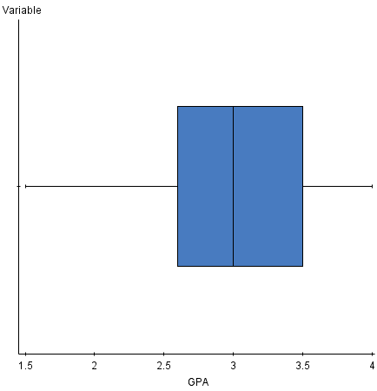
GPA

Slide 8
GPA
The second qualitative variable is the GPA of students we interviewed.
Listed below is the data for GPA listed in ascending order.
Outliers: Q3-Q1=IQR 3.5-2.6= 0.9
Q1-1.5(IQR)= Outlier 2.6-1.5(0.9)= 1.25
Q3+1.5(IQR)= Outlier 3.5+1.5(0.9)= 4.85
There are no outliers for this data.
Minimum
Median
1.5 | 2 | 2 | 2 | 2 | 2.1 | 2.1 | 2.2 | 2.3 | 2.3 | 2.4 | 2.4 | 2.5 | 2.5 | 2.5 | 2.5 | 2.5 | 2.5 | 2.5 | 2.5 | 2.5 | 2.5 | 2.5 | 2.5 | 2.6
2.6 | 2.7 | 2.7 | 2.7 | 2.75 | 2.76 | 2.79 | 2.85 | 2.9 | 2.9 | 2.9 | 2.9 | 2.9 | 2.9 | 2.9 | 2.95 | 2.96 | 3 | 3 | 3 | 3 | 3 | 3 | 3 | 3
3 | 3 | 3 | 3 | 3 | 3.06 | 3.1 | 3.1 | 3.1 | 3.2 | 3.2 | 3.2 | 3.3 | 3.3 | 3.35 | 3.4 | 3.4 | 3.4 | 3.45 | 3.5 | 3.5 | 3.5 | 3.5 | 3.5 | 3.5
3.5 | 3.5 | 3.62 | 3.7 | 3.7 | 3.7 | 3.7 | 3.78 | 3.8 | 3.8 | 3.8 | 3.8 | 3.8 | 3.8 | 3.86 | 3.9 | 3.9 | 3.9 | 3.9 | 3.92 | 4 | 4 | 4 | 4 | 4
1st Quartile
Maximum
3rd Quartile

Slide 9
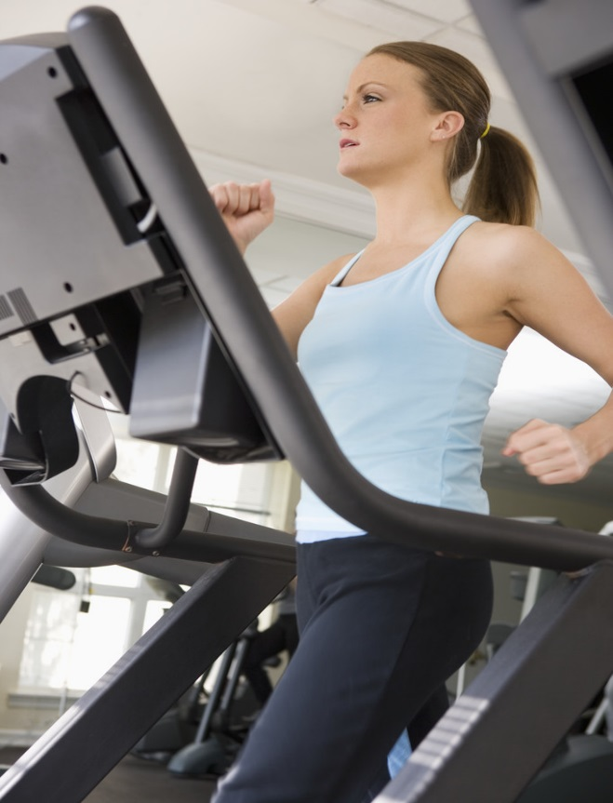

Does increased hours of exercise per week result in higher cumulative GPA?

Slide 10
Correlation Analysis

Slide 11
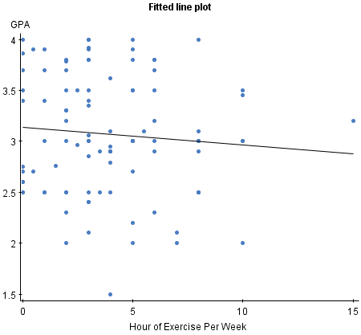
Scatter Plot

Slide 12
Simple linear regression results:
Parameter estimates:
Parameter estimates:
Analysis of variance table for regression model:
Parameter | Estimate | Std. Err. | Alternative | DF | T-Stat | P-Value
Intercept | 3.1364536 | 0.09839 | ≠ 0 | 98 | 31.877768 | <0.0001
Slope | -0.01720754 | 0.02025326 | ≠ 0 | 98 | -0.84961826 | 0.3976
Source | DF | SS | MS | F-stat | P-value
Model | 1 | 0.24379642 | 0.24379642 | 0.72185117 | 0.3976
Error | 98 | 33.098305 | 0.3377378
Total | 99 | 33.3421

Slide 13
Simple linear regression results:
Dependent Variable: GPA
Independent Variable: Hour of Exercise per Week
y = 3.1364536 - 0.01720754 x
Sample size: 100
R (correlation coefficient) = -0.0855
R-sq = 0.0073119695
Estimate of error standard deviation: 0.58115214

Slide 14
Surprises/difficulties
Our group was working with a large sample size and found it somewhat difficult dealing with the calculations of so much data. It took quite a bit of time to do the calculations for 100 data points for each of the variables and to double check each of the results.
Our group wasn’t sure if our data would show a strong correlation between the hours of exercise per week and GPA but suspected that increased exercise might lead to doing better in school.
Our data ended up surprising us by showing a moderate negative correlation between the hours of exercise per week and GPA for the students we interviewed.

Slide 15
Analysis
We’ve realized that the majority of people are exercise very little each week so the histogram showed that the graph is skewed to the right. The GPA are more distributed out evenly in the histogram graph. Both variance showed a mean of 3. The correlation appeared to be very weak between the two variance because it’s very close to being 0 and the regression line is going downward. The critical value in table II at 0.05 level of significant is .195 which is greater than our R value. Therefore we believe that our data for just the hour of exercise and GPA does not have a correlation relationship with each other.

Slide 16
Conclusion
In conclusion, we believe that our hypothesis of trying to prove that the more hours that the student exercise per week, the better GPA that they can get is not true. It doesn’t have any correlation between the two due to lack of other factor like the age of the student, how many credit does the student take during the semester, and how many hour does the student work during the week. If we have to repeat the project, we will take the other factor into consideration instead of just the two factor to be able to form a stronger data and correlation between all of the factors.

