Slide 1
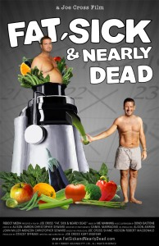
Fat, Sick & Nearly Dead Movie Review
Director: Joe Cross
Staring: Joe Cross and Phil Staples
Time: 1 hour 37 minutes
This inspiring documentary starts out following a 41 year old successful Australian businessman, named Joe Cross. He weighs 310 lbs. and has an autoimmune disorder. He says he has spent his life, “putting wealth before health.” Now as his health is deteriorating, Joe decides it’s now or never to change his life.
Although, as soon as you start this movie you know how it’s going to end (fat and sick to skinny and healthy), it is worth watching for the inspiration and motivation to eat healthier. In Joe’s case, his weight makes it so he can’t enjoy all the activities he used to and his auto immune disorder leaves him with intense blistering painful rashes that he has to take several medications for. Now Joe wants to better his life by becoming a happier, healthier person. He decides to document his life changes in this movie to have more pressure to succeed and to help people realize that if he can do it, so can they. Joe’s transformation during this movie is nothing short of amazing.

Slide 2
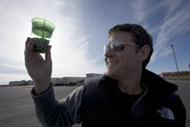
“ As a percentage of calories, roughly 60% of what we eat is mostly processed and refined foods, 30% animal products, 5% whole grains and white potato, and just 5% fruits and vegetables.”
Dr. Fuhrman
(Joe’s Nutritionist)
Joe Cross decides to come to New York, which he calls, “his home away from home,” and start a 60 day juice fast. The only thing he will eat for an entire 60 days is juiced fruit and vegetables. Before beginning this fast, he does seek the advice of both a nutritionist and a doctor to make sure his body can handle the fast. The doctor gives him the all clear, but wants to weekly monitor him. The nutritionist talks about how the United States is extremely dependent on processed foods and how most American aren’t getting close to enough fruits and vegetables in their diets.
Although 60 days of having nothing but juice is extreme, the diet does seem to restart his metabolism. He has amazing weight loss results, which is chronicled in the movie. Joe expresses the difficulty of only having juice for the first 3-4 days. He says he can’t even watch TV because the commercials of food make him too hungry and he can’t think because his head is in such a fog. But after the 3-4 days, he has more energy than he’s felt in a really long time. Overall, the theme of this movie is great ( lose weight and get healthy) but it does spend a lot of time focusing on juicing and the benefits of using a juicer.

Slide 3

“The thing I’m finding remarkable about people is they say, Oh, I couldn’t do that. Why aren’t they even giving it a try? I just don’t understand that, you know, if you get into a 10-day juice fast and then you quit at day 7, well good on you for trying. Not, oh you’re a failure, just good on you for trying.” –Joe Cross
Joe spends some time in New York talking to people on the street about his juice cleanse and trying to get locals to try his juice. Again, the movie is focusing heavily on the benefits of Joe’s juicer. The pace in this section of the movie really slows down. The movie begins to focus on what other people think of his fast, which is mostly just how crazy, extreme, or unhealthy the diet seems. Those people who do think it is a great idea, say they wouldn’t have the willpower to do it themselves. The movie didn’t need to interview so many people telling him how crazy he is, it seemed a bit excessive and unnecessary.
Joe does spend does time talking about his own accountability. He is this way because he let himself put everything else before his health. At about 30 days into the fast, you can see that Joe has lost a large amount of weight. He looks quite a bit different than when he first started. Also, he says he hasn’t had any blister flares from his autoimmune disease since after the first week of starting this fast, where normally he had flares daily. The fast does seem to be helping him get to the better, healthier life he was hoping for.

Slide 4
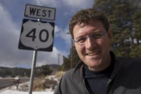
Joe decides to head on the road to drive across America. He is going to finish his last month of the juice cleanse on the road, while encouraging other people to join him. While on the road he meets a lady from Iowa, named Siong Norte, who agrees to join him on his juice fast for 10 days. While she is not overweight she suffers from constant extreme migraines. She wants to see if the juice fast can help her migraines. She is only in the movie for a few minutes but does explain that although it was very difficult to do, the juice fast did help her migraines. The frequency she normally had the migraines was significantly reduced. Siong really feels that all the processed foods in her diet contributes to her migraines. Overall, at the end of the juice cleanse she feels much healthier. During her interviews, it is a bit obvious that Siong doesn’t have much experience in front of a camera but since she is an just average Joe trying to get healthier, it makes her more believable.

Slide 5
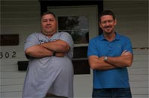
I was glad that the movie transitioned from Joe’s to Phil’s story because I don’t think Joe’s story alone was enough to make a full movie. The documentary really needed another success story to make it so inspirational and to keep the viewer's interest. Phil’s transformation is even more incredible than Joe’s to watch.
At the beginning Phil is very depressed about his life. He can barely even walk around without being in pain from the weight. You can’t help but to feel a bit sorry for him. He sees a doctor and while trying to get the ok to start the juice fast, he finds out he is too overweight to even lay on the traditional machines. It obvious that this deeply hurts him and you can see the pain that being overweight has caused him emotionally. He does end up getting the doctor’s ok to do the juice fast. He begins juicing and getting small amounts of exercise. The weight starts melting off of him. His attitude completely changes. He is smiling and excited about what the future holds for him as a healthier, more fit person. He is excited by the idea of being fit enough to throw around a football with his youngest son and it determined to do whatever it takes to make that happen.

Slide 6
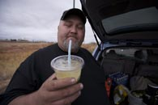
Next, while at a truck stop, Joe meets a 430 lb. man named Phil Staples. He who suffers from the same autoimmune disorder. This seems a bit too coincidental. Joe has explained earlier in the movie how rare this autoimmune disease it and it seems unlikely for him to bump into a truck driver sharing the same disease, and they happen to strike up a conversation on it in the parking lot of a truck stop.
Joe encourages Phil to join him on the fast, telling him what a difference it has made to his life and the effects of the disease. Phil responds to Joe with a kind of, good for you, but a 60 day juice fast isn’t for me response. After a few days, Phil calls Joe and says he has changed his mind. He is ready to change his life to be a healthier, happier person. Phil really wants to be around to see his youngest son grow up. Joe gets Phil a juicer and gets him started on his own juice fast. The movie then concludes chronicling Joe’s 60 days juice fast, which he has lost 73 pounds on. It begins recording Phil’s life changes during his own 60 day juice fast.

Slide 7
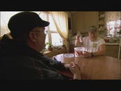
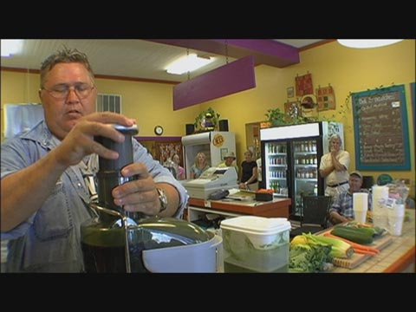
In the middle of Phil’s 60 day juice fast his brother, Bear, who is also overweight, suffers a mild heart attack. This really inspires Phil to stick to the fast but he also gets his brother on board the juice fast as well.
During Phil’s transformation, he hosts meetings at a nearby Organic Grocery store, encouraging others to try the diet. At this point, the documentary seems to pushing the juicers at bit. It seems to come across as a juicer promotion. This doesn’t really take away from the amazing changes Phil has made though.
By the end of Phil’s juice diet he has lost 91 lbs. and has dramatically reduced the amount of medications he has to take. He decides to quit his job as a truck driver because it is not conducive to his new healthy lifestyle. Phil looks and acts like a whole new person. He is jogging, eating healthy, and playing ball with his son. He is definitely enjoying his life and has made some incredible life changes.

Slide 8
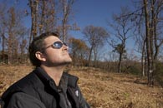
Fat, Sick & nearly dead was a documentary well worth watching. Joe and Phil’s story was very inspiring and motivational. The movie was a bit slow paced at times and to help this I felt like it could have left some of the interviews out, while still achieving the same end result. At certain times when the actors were talking, it did feel like you were watching the testimonials from an infomercial. In fact, the documentary does promote juicers as a product repeatedly through out the movie. Even so, I didn’t feel like the promotion of the juicers took away from the men’s amazing results.
While this documentary definitely stresses juice fasting and the many benefits of juice, it does spend a good amount of time talking about the importance of having a balanced lifestyle. If we focus too much on one thing in our lives (like work) than the rest of the things ( like our health) in our life will suffer because of it. Although I feel 60 days on nothing but juice is extreme and should be done with caution, it seems to have changed Joe and Phil’s life for the better.
Overall, I enjoyed watching this movie and walked away from it thinking that they way most Americans eat is slowly killing us. We, as a nation, are very dependent on processed and easy foods. We should all resolve to incorporate more fruits and vegetables into our daily diets. Joe Cross has made it his new life goal to promote and teach about the importance of fasting and cleanses as a way to restart our metabolisms. This was an inspiring documentary and it was wonderful to see the men’s transformations.

