Slide 1
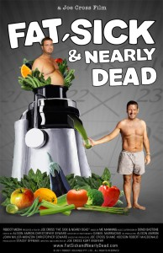
Fat, Sick & Nearly Dead Movie Review
Director: Joe Cross
Staring: Joe Cross and Phil Staples
Time: 1 hour 37 minutes
This is an inspiring documentary
It starts out following a 41 year old successful Australian businessman, named Joe Cross.
He weighs 310 lbs. and has an autoimmune disorder.
He says he has spent his life, “putting wealth before health.” Now as his health is deteriorating, Joe decides it’s now or never to change his life.
As soon as you start this movie you know how it’s going to end (fat and sick to skinny and healthy), but it is worth watching for the inspiration and motivation to eat healthier.
In Joe’s case, his weight makes it so he can’t enjoy all the activities he used to and his auto immune disorder leaves him with intense blistering painful rashes that he has to take several medications for.
Joe wants to better his life by becoming a happier, healthier person.

Slide 2

Joe Cross decides to come to New York and start a 60 day juice fast where the only thing he will eat for an entire 60 days is juiced fruit and vegetables. This diet seems extreme and unhealthy but Joe does get a doctor’s approval to try the diet.
Joe expresses the difficulty of only having juice for the first 3-4 days. But after the 3-4 days, he has more energy than he’s felt in a really long time.
Joe spends some time in New York talking to people on the street about his juice cleanse and trying to get locals to try his juice. This part of the movie does seem like a promotion for juicers.
Joe acknowledges that he is this way because he let himself put everything else, specifically wealth, before his health.
At about 30 days into the fast, you can see that Joe has lost a large amount of weight
He says he hasn’t had any blister flares from his autoimmune disease since after the first week of starting this fast, where normally he had flares daily
“The thing I’m finding remarkable about people is they say, Oh, I couldn’t do that. Why aren’t they even giving it a try? I just don’t understand that, you know, if you get into a 10-day juice fast and then you quit at day 7, well good on you for trying. Not, oh you’re a failure, just good on you for trying.” –Joe Cross

Slide 3
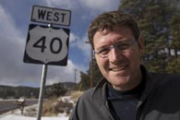
Joe decides to head on the road to drive across America encouraging other people to join him and promoting his juicers
I found this part of the movie very slow paced and too much focused on the juicers
Joe describes that it is not just about juice fasting to lose weight but it is about our overall health. He suggests eating unprocessed healthy foods and exercising more.
Joe says he now realizes that he needs to be more balanced in every aspect of his life, which I think is something we all need to remember. I know I could benefit from a more balanced life.

Slide 4
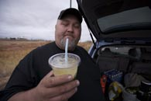
Also, on the road Joe meets a 430 lb. man named Phil Staples who suffers from the same autoimmune disorder.
This seems a bit too coincidental. Joe has explained earlier in the movie how rare this autoimmune disease it and it seems unlikely for him to bump into a truck driver sharing the same disease, and they happen to strike up a conversation on it in the parking lot of a truck stop.
Joe encourages Phil to join him on the fast, telling him what a difference it has made to his life and the effects of the disease.
After a few days, Phil calls Joe and says he is ready to change his life to be a healthier, happier person
Joe gets Phil a juicer and gets him started on his own juice fast.
The movie then concludes chronicling Joe’s 60 days juice fast, which he has lost 73 pounds on. It begins recording Phil’s life changes during his own 60 day juice fast.
I was glad that the movie transitioned from Joe’s to Phil’s story because I don’t think Joe’s story alone was enough to make a full movie.

Slide 5
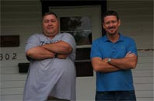
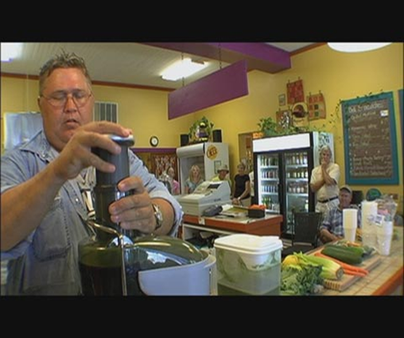
Phil’s transformation is even more incredible than Joe’s to watch.
He is very depressed about his life. He can barely even walk around without being in pain from the weight. He is emotionally hurt by his weight. You can’t help but to feel a bit sorry for him.
He begins juicing and getting small amounts of exercise. The weight starts melting off of him and his attitude completely changes
This part of the movie is very motivational and it is great to see Phil’s changes
During Phil’s transformation, he hosts meetings at a nearby Organic Grocery store, encouraging others to try the diet.
At this point, the documentary seems to pushing the juicers and it comes across as a juice promotion
By the end of Phil’s juice diet he has lost 91 lbs. and has dramatically reduced the amount of medications he has to take.
He is jogging, eating healthy, and playing ball with his son. He is definitely enjoying his life and has made some incredible life changes.

Slide 6
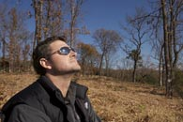
Fat, Sick & nearly dead was a documentary well worth watching.
Joe and Phil’s story was very inspiring and motivational.
The movie was a bit slow paced at times and to help this I felt like it could have left some of the interviews out, while still achieving the same end result.
At times when the actors were talking, it did feel like you were watching the testimonials from an infomercial.
the documentary does promote juicers as a product repeatedly through out the movie.
Overall, I enjoyed watching this movie. The movie helped me to realize that if we focus too much on one thing in our lives (like work) than the rest of the things ( like our health) in our life will suffer because of it.
My opinion of Joe and Phil’s juice fast is that it is extreme and should be done with caution, but it seems to have changed Joe and Phil’s life for the better.

